Slide 1
TABLEAU

Slide 2
INTRODUCTION
Tableau is the fastly growing and powerful data visualization tool. Tableau is a business intelligence tool which helps us to analyze the raw data in the form of the visual manner; it may be a graph, report, etc.
Example: - If you have any data like Big Data, Hadoop, SQL, or any cloud data and if you want to analyze that given data in the form of pictorial representation of data, you can use Tableau.
Data analysis is very fast with Tableau, and the visualizations created are in the form of worksheets and dashboards. Any professional can understand the data created using Tableau.
Tableau software doesn't require any technical or any programming skills to operate. Tableau is easy and fast for creating visual dashboards.

Slide 3
Here are some reasons to use Tableau:
Ultimate skill for Data Science
User-Friendly
Apply to any Business
Fast and Easy
You don't need to do any Coding
Community is Huge
Hold the power of data
It makes it easier to understand and explain the Data Reports
Features of Tableau
Data Blending: Data blending is the most important feature in Tableau. It is used when we combine related data from multiple data sources, which you want to analyze together in a single view, and represent in the form of a graph.

Slide 4
Real-time analysis: Real-Time Analysis makes users able to quickly understand and analyze dynamic data, when the Velocity is high, and real-time analysis of data is complicated. Tableau can help extract valuable information from fast moving data with interactive analytics.
The Collaboration of data: Data analysis is not isolating task. That's why Tableau is built for collaboration. Team members can share data, make follow up queries, and forward easy-to-digest visualizations to others who could gain value from the data. Making sure everyone understands the data and can make informed decisions is critical to success.

Slide 5
INSTALLATION OF TABLEAU
Tableau is available in two ways:-
Tableau Public (Free)
Tableau Desktop (Commercial)
Tableau Public
Tableau Public is a free and open-source.
Tableau public data source can connect to Excel and Text files.
Tableau public can be installed on Window and Mac operating system.
Data and Visualizations are not secured in the Tableau public because it is available in public.
In Tableau public, data cannot be obtained from different data sources as it is limited to connect only Excel and Text files.
Tableau public uses the details at Personal level.

Slide 6
Tableau Desktop
.
Step1:- Go to https://www.tableau.com/products/desktop on your Web browser.
Step2:- Click on the 'Try Now' button.
Step3:- Now, enter your Email id and click on the 'Download Free Trial' button.
Step4:- This will start downloading the .exe File for window machine by default.
Step5:- Open the download file, and click on the 'Run' button
.

Slide 7
Step6:- Accept the terms and condition and click on 'Install' button.
Step7:- A pop message will be shown on the screen to get the approval of the administrator to install the Tableau software. Click on 'yes' to approve it than installation will be started.
Step8:- Once the installation is completed, then open the Tableau desktop software.
Step9:- In the registration window
Click on Activate Tableau and fill your complete details.
Click on start trial now.
Step10:- Wait for complete registration.
Step11:- Start screen of the Tableau Desktop.

Slide 8
Bar Charts
Bar charts is give differences between categories, show trends and outliers, and reveal historical highs and lows at a glance. It is split into many categories
Steps
Go to a new worksheet.
Drag Category into Column.
Drag Profit into Rows
Go to the Marks card and select the Bar option.

Slide 9
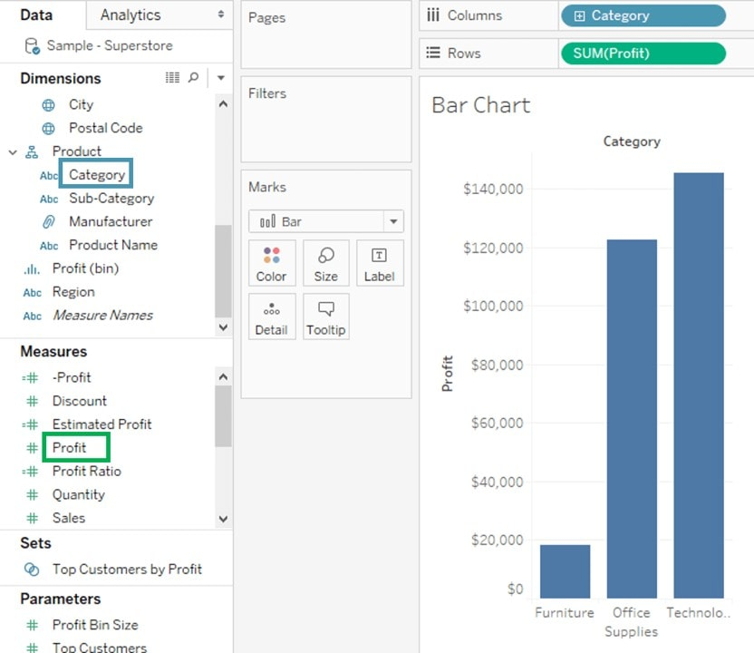
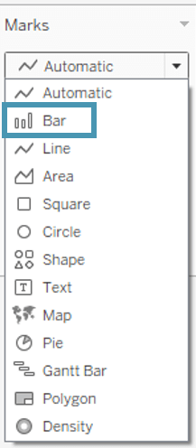

Slide 10
Line Chart
The line chart, or line graph, is another familiar method for displaying data. It connects several distinct data points, presenting them as one continuous evolution.
Steps
Go to a new Worksheet
Drag Order Date into Columns.
Drag Sales into Rows.
Go to the Marks card and select the Line option.

Slide 11
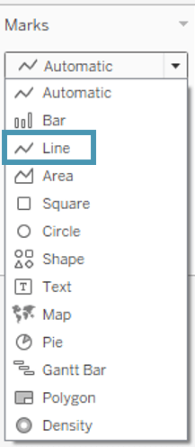
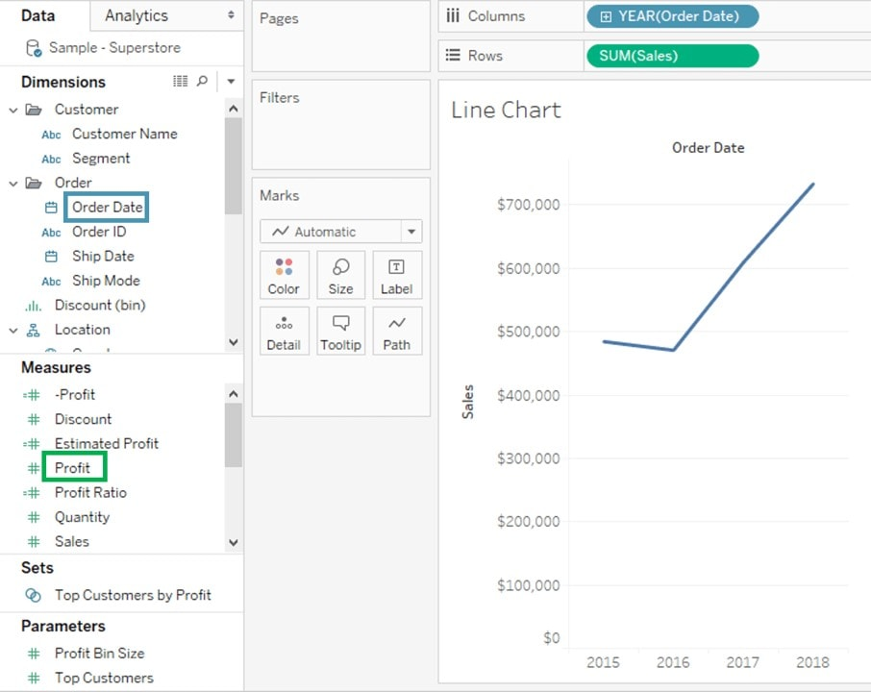

Slide 12
Area Chart
Area charts represent any quantitative data over various periods of time. It is basically a line graph where the area between line and axis is generally filled with color.
Steps
Go to a new Worksheet.
Hold the control key in keyboard and select Order Date and Quantity.
Click on Show Me option present at the top right corner of the worksheet
Select the Area Chart icon as shown in the figure.
Drag Region from dimension pane and add it in Color icon of Marks card.

Slide 13
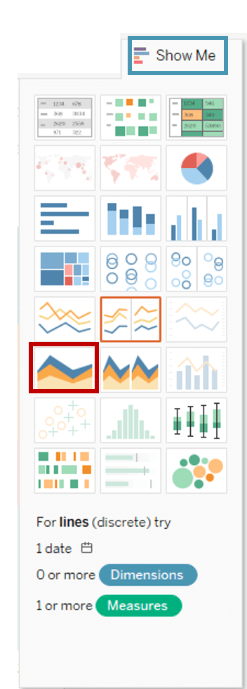
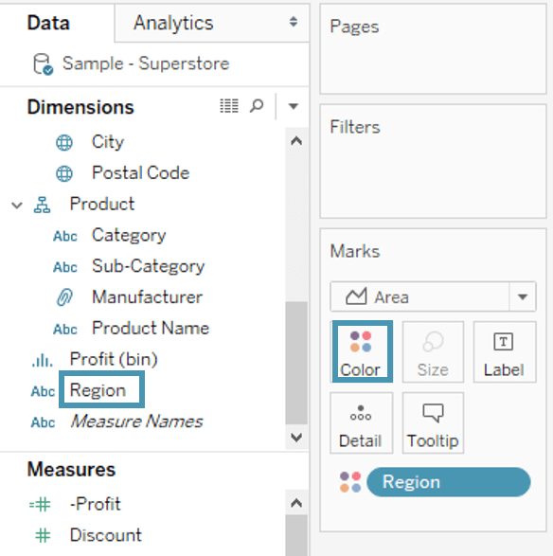

Slide 14
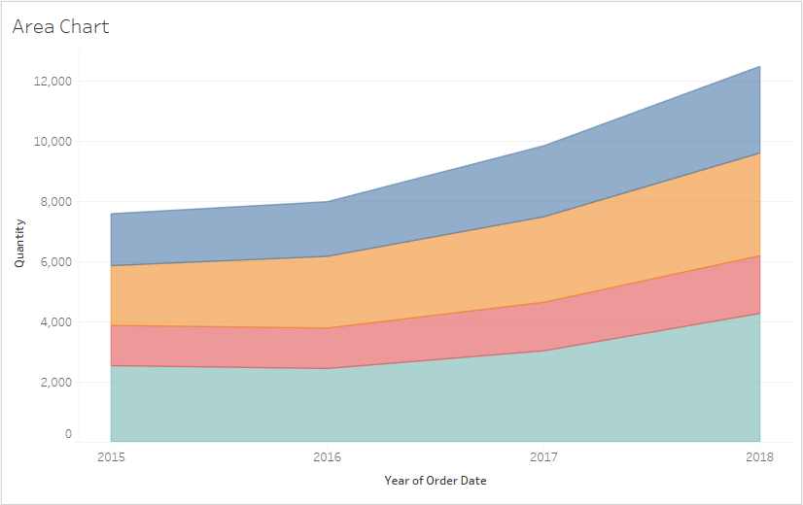

Slide 15
Pie Charts
Pie charts are powerful for adding detail to other visualizations. The angle of the pie determines the measured value. Different colors can be assigned to pie to represent the members in a dimension.
Steps
Go to a new Worksheet
Select Segment and Sales from data pane.
Click on ShowMe button present in the top right corner of the worksheet.
Select Pie Chart from the list.

Slide 16
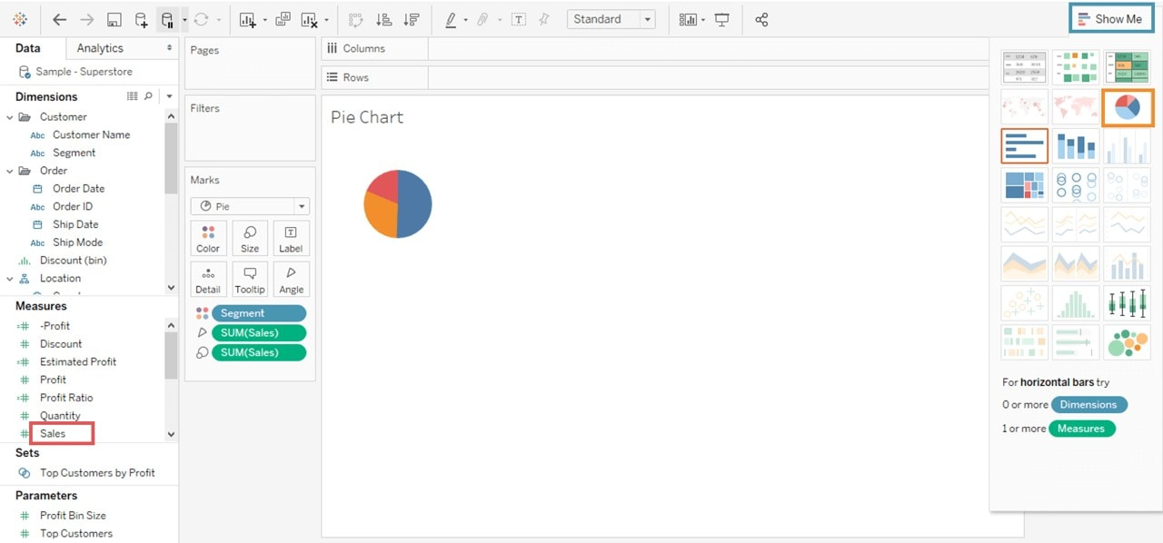

Slide 17
Bubble Charts
Although bubbles aren’t technically their own type of visualization, using them as a technique adds great detail to scatter plots or maps. Varying the size and color of circles creates visually compelling charts that present large volumes of data at once. It can add more detail to the traditional two-axis chart, highlighting the relationship between three or more variables, without overwhelming the viewer.
Steps
Go to a new Worksheet.
  1.Hold on the Control key on the keyboard.
  2.Click on Sub-Category and Sales.
Click on the Show Me option

Slide 18
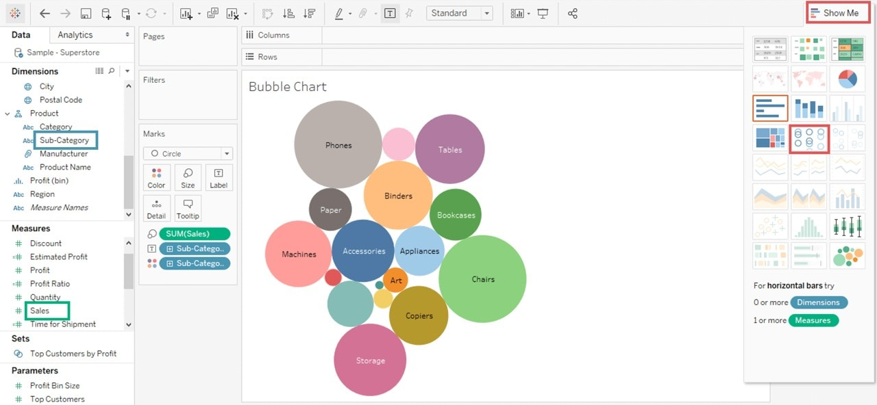

Slide 19
Heat Maps
Heat maps are a great way to compare data across two or more categories using color. Patterns guide viewers around the chart, quickly showing them where the intersection of categories is strongest and weakest. Heat maps are best for presenting data sets with lots of categories.
Steps
Go to a new Worksheet.
Hold the control key in keyboard and select Sub-Category and Sales from the data pane.
Click on the Show me button present in the top right corner of the worksheet.
Select the Heat Map icon as shown in the image.
Drag Profit into the Color box.

Slide 20
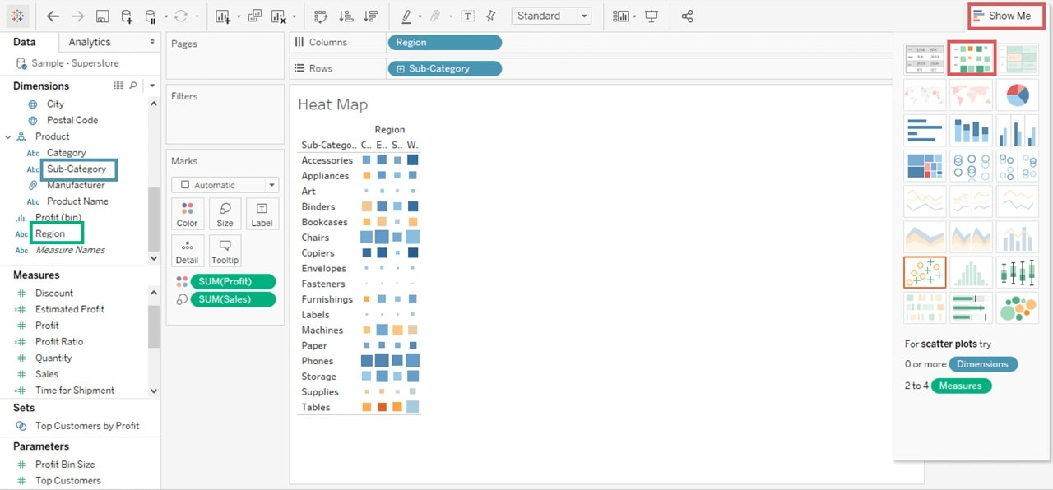

Slide 21
Scatter Plots
A scatter plot presents lots of distinct data points on a single chart. The chart can then be enhanced with analytics like cluster analysis or trend lines. Scatter plots are used to show if one variable is a good predictor of another, or if they tend to change independently. This type of chart easily lends itself to many types of analysis.
Steps
Go to a new Worksheet.
Drag Discount into Columns.
Drag Sales into Rows.
Drag Sub-Category into Color icon present in the Marks card

Slide 22
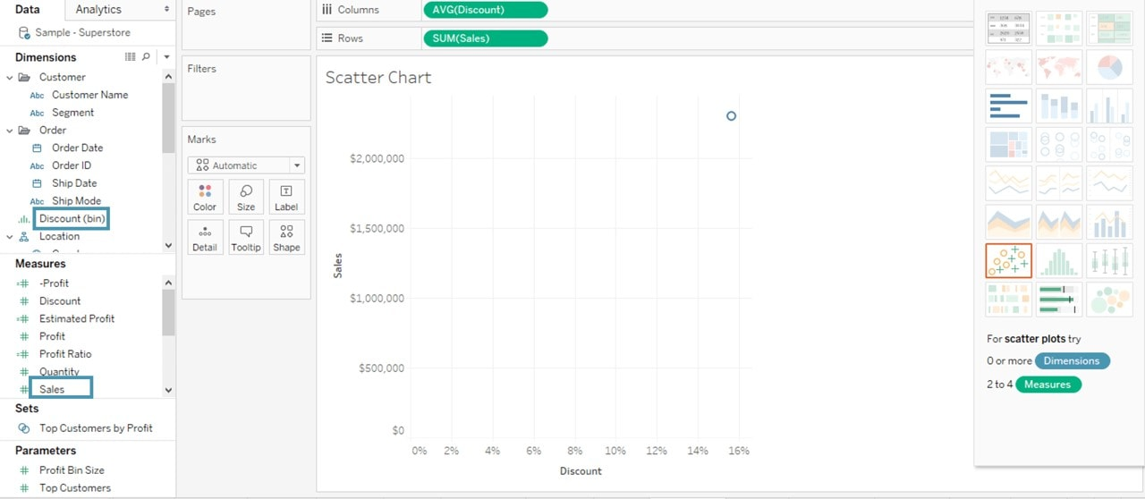

Slide 23
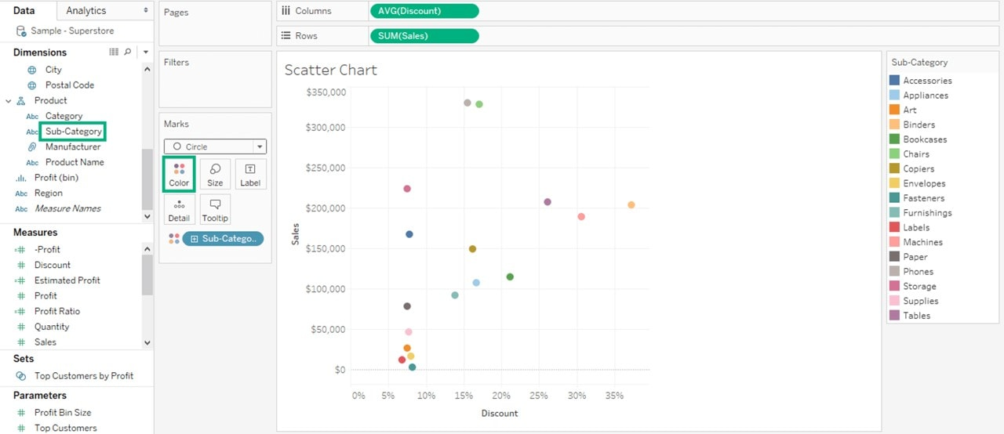

Slide 24
FILTERS IN TABLEAU
There are in total 6 types of filters in Tableau, which are,
Extract Filters
Data Source Filters
Context Filters
Dimension Filters
Measure Filters
Table Filters

Slide 25
Extract Filters
Tableau allows you to have a data source, either live or an extracted or copied one. Live data source would mean, any changes done in the data source will almost immediately reflect in Tableau.
Extract, on the other hand, is a copy of the original data and will not reflect any changes made to the data source unless you decide to reload the data once again after the changes to the original data are saved.
During the extraction of data, Tableau allows you to add filters to the columns being extracted from the data source.
You could filter out columns based on whole columns or values within the column(s).
A small and quick example might help put things in perspective. You could add any type of flat file which is called as tabular file, that contains data in rows and columns .

Slide 26
Click on the extract radio button
To create a local registry
Click on the edit button
Click on add filter criterion from the dialogue box
From that choose any of the column relevant business
Another window pops up with a selection of values within the selected column. You could then select any particular value and either choose to include or exclude (option at the bottom of the list on the right).

Slide 27
Data source filter
A data source filter applies the filter to the data source directly, enabling quick uploads of data that qualify into the Tableau workbook.
To add a Data Source filter, select the Data Source page or tab in Tableau.
From the given sources right click on the applicable data source and select Edit Data Source Filters.
Click on Add to bring up the Add Filter dialog box, which lists the fields in the selected data source.
Now Select a filter and proceed just like the way we did with Extract filters.
Data Filters are primarily used to restricting data that is available to users when the workbook is published.

Slide 28
Context filters
Context Filters are used to improve performance of views, filters, and queries run on a data source.
All filters by default are applied independently of any other filters in Tableau, which means each filter accesses the entire data set without regard to any other filters.
A context filter can be applied to change this behaviour.
You could have a context filter that is run before any other filters, and the rest of the filters are applied on top of the data returned after context filtering.
To create a context filter,
click on Add to Context on the contextual menu of any existing categorical filter.
The context is computed first, generating the view.
The rest of the filters are then computed over the view generated by the context filter.

Slide 29
Dimension filters
Dimensions in Tableau are fields that are independent, typically any field that contains categorical or qualitative information
Filters applied on such dimensional data are called Dimension Filters.
You can choose any of the dimensions listed by Tableau for your data, drag them to the Filters box.
The members or values of the dimension are displayed. You can choose to select or deselect these members completely or use wildcard selection or even a condition-based selection where you can use complex formulas or simple conditions to filter out data.

Slide 30
Measure filters
Filters that are applied to a measure filed are called Measure Filters.
Measures are typically fields that contain quantitative data.
To add a measure filter, you could drag a measure filed into the Filter box.
In the resulting Filter window, select desired aggregation and click Next.
The window that pops up allows you to further narrow your filter using, Range of values, At Least, At Most and Special sub filters.
Here are a couple of screen grabs that show the same.

Slide 31
Filter condition in tableau
Depending on the type of file that you have chosen to filter on, Tableau presents a Filter dialog box
Click on Custom value list, Tableau allows you to added one or more categories to make a custom list of categories.
The Wildcard page will let you filter in or out data based on values of dimensions. Conditions like Contains starts with and Ends With help you narrow down the dataset.

Slide 32
The Wildcard page will let you filter in or out data based on values of dimensions. Conditions like Contains starts with and Ends With help you narrow down the dataset.
The Condition tab on the Filter dialog box, lets you filter in data by specifying several conditions values within the measure fields.

Slide 33
Dashboard
A dashboard is a collection of different kinds of visualizations or views that we create on Tableau.
We can bring together different elements of multiple worksheets and put them on a single dashboard.
The dashboard option enables us to import and add charts and graphs from worksheets to create a dashboard.
On a dashboard, we can place relevant charts and graphs in one view and analyze them for better insights

Slide 34
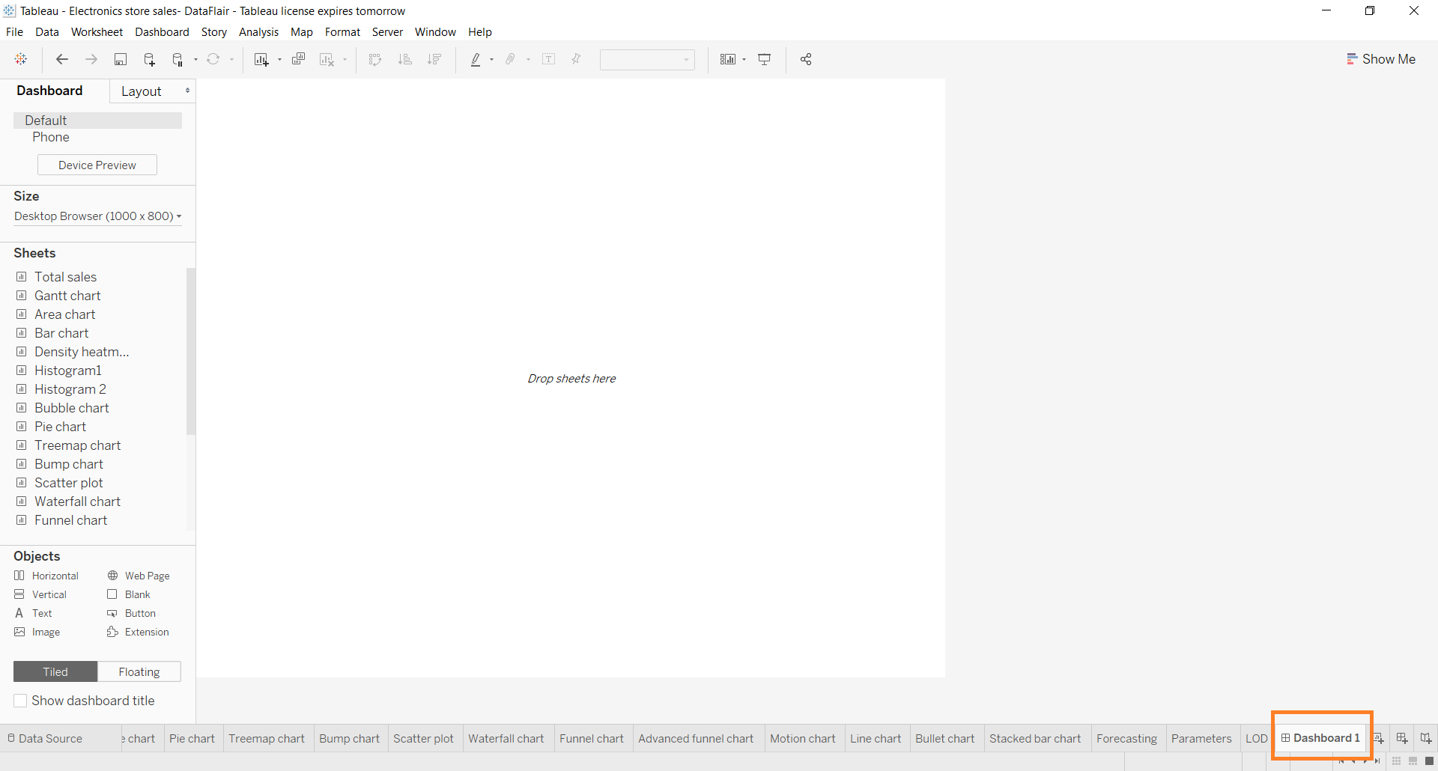
Open a new dashboard
Menu bar> Dashboard>new dashboard

Slide 35
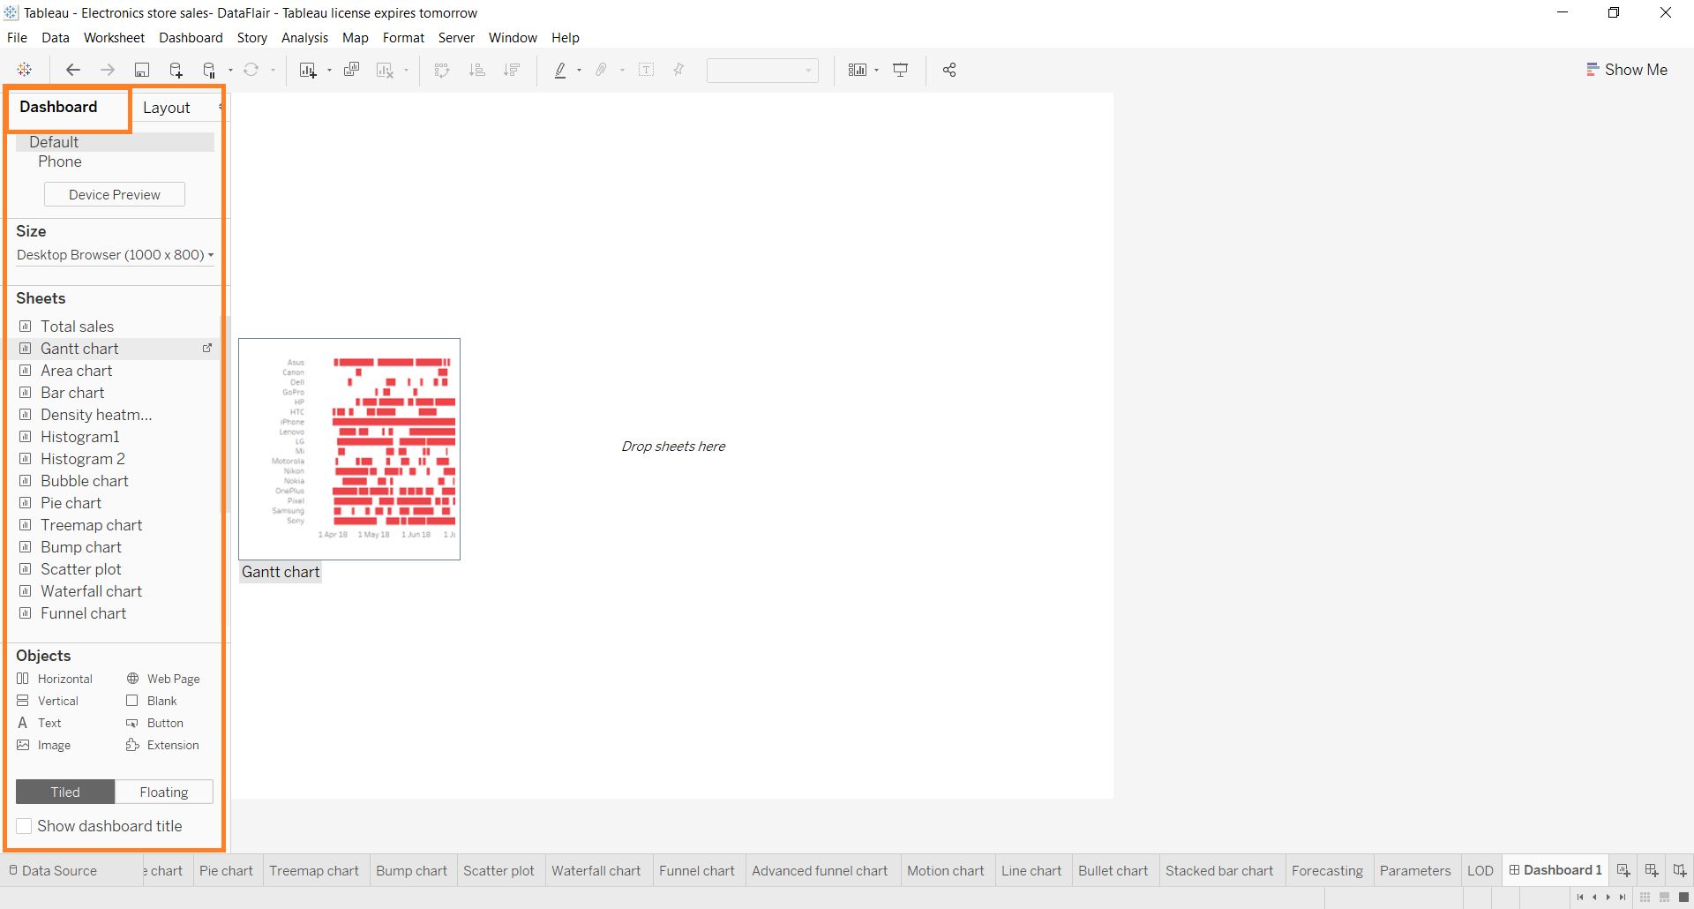
Dashboard pane
There are more features in dashboard pane like
You can set the size of dashboard

Slide 36
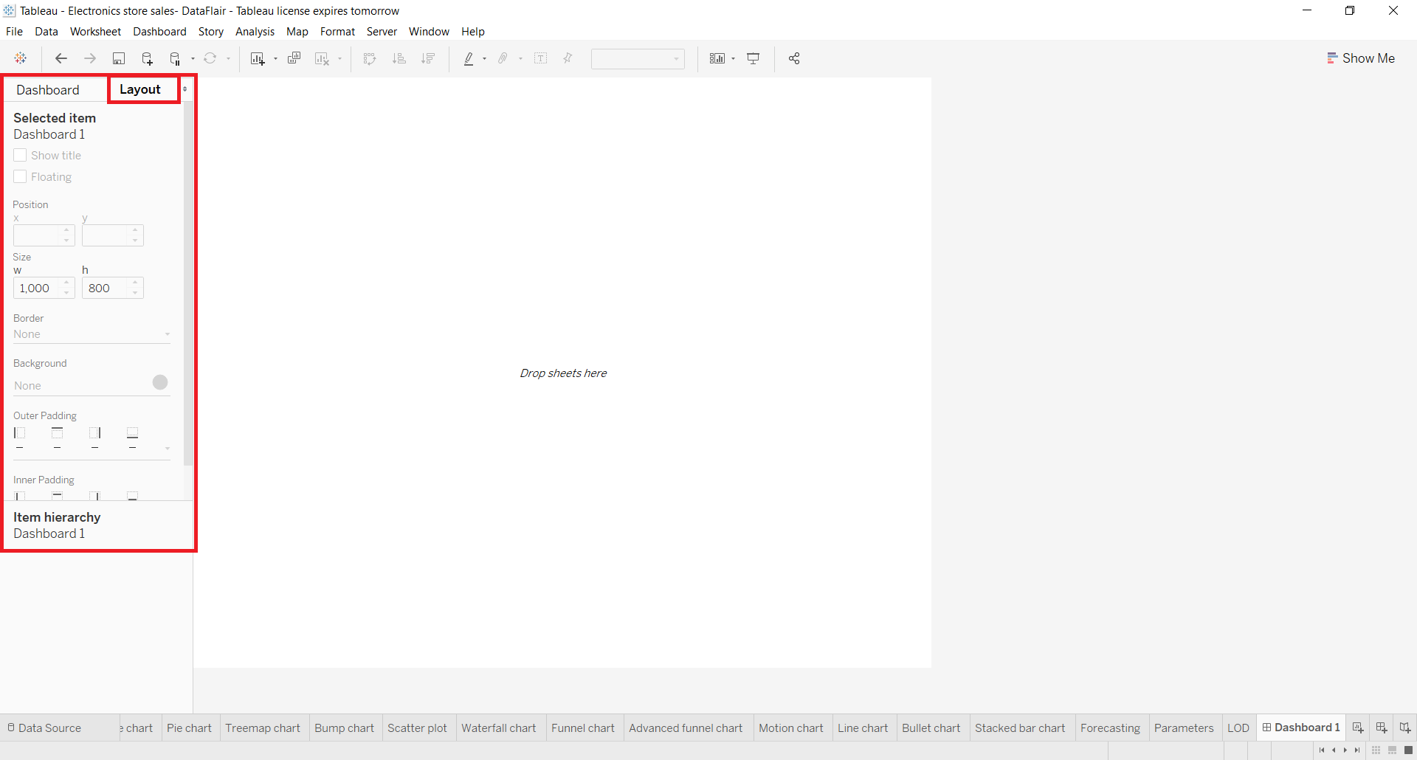
Layout pane
Layout pane where we can enhance the appearance and layout of the dashboard by setting the position, size, border, background, and paddings.

Slide 37
Adding a sheet
Lets add an empty sheet. drag and drop a sheet from the Sheets column present in the Dashboard tab.
To click on the graph then click on the small downward arrow given at the right.
select floating from the drop down menu. This will unfix your chart from one position so that you can adjust it as per your liking
In a similar way, we can add as many sheets as we require and arrange them on the dashboard properly.

Slide 38
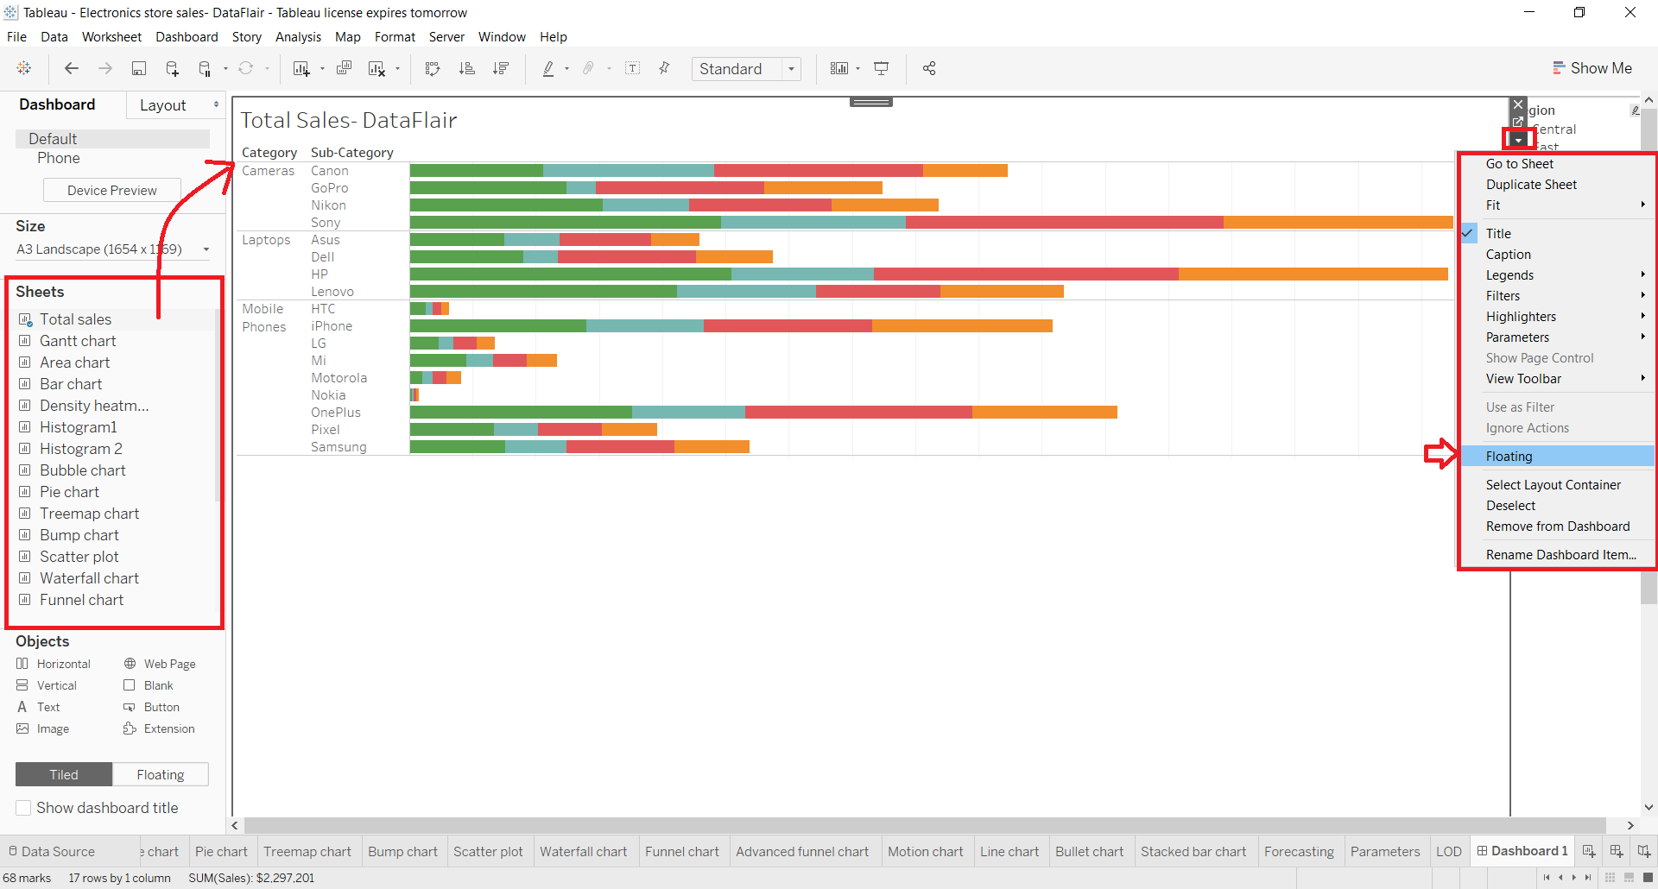

Slide 39
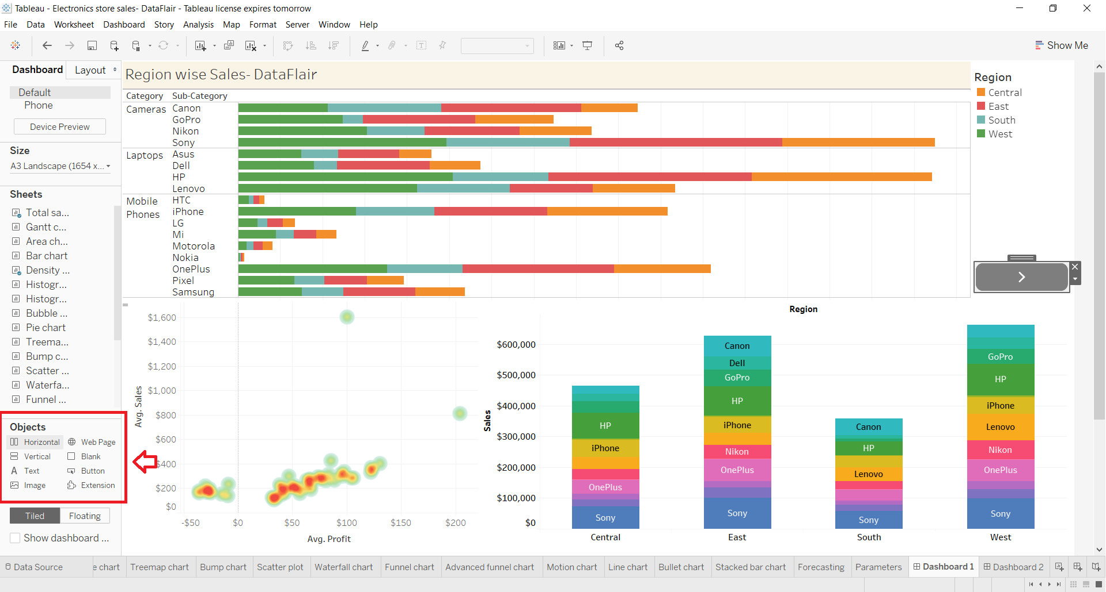
Adding objects
Another set of tools that we get to make our dashboard more interactive and dynamic is in the Objects section. We can add a wide variety of objects such as a web page, button, text box, extension, etc

Slide 40
Final dashboard
We can add filters on this dashboard by clicking on a visual. For instance, we want to add a filter based on months on the scatter plot showing sales values for different clusters. To add a months filter, we click on the small downward arrow and then select Filters option. Then we select Months of Order Date option. You can select any field based on which you wish to create a new filter

Slide 41
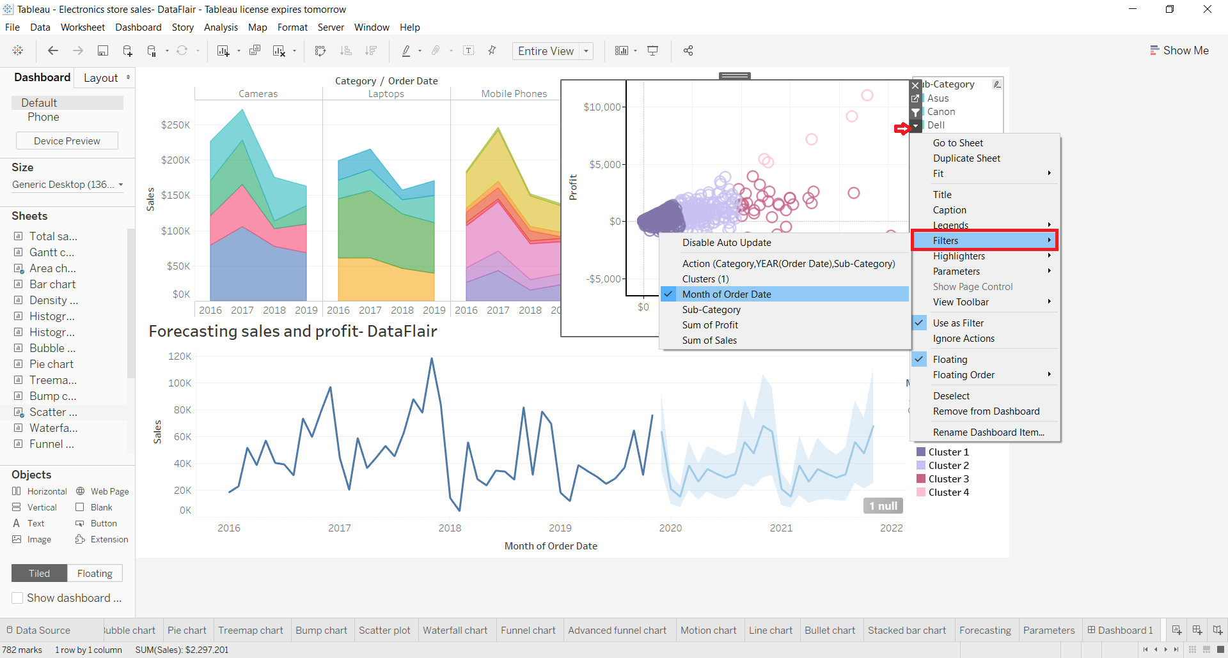

Slide 42
THANK YOU

